Slide 1

Nagy Dávid
Tokodi Mihály
Lehel Barnabás

Slide 2
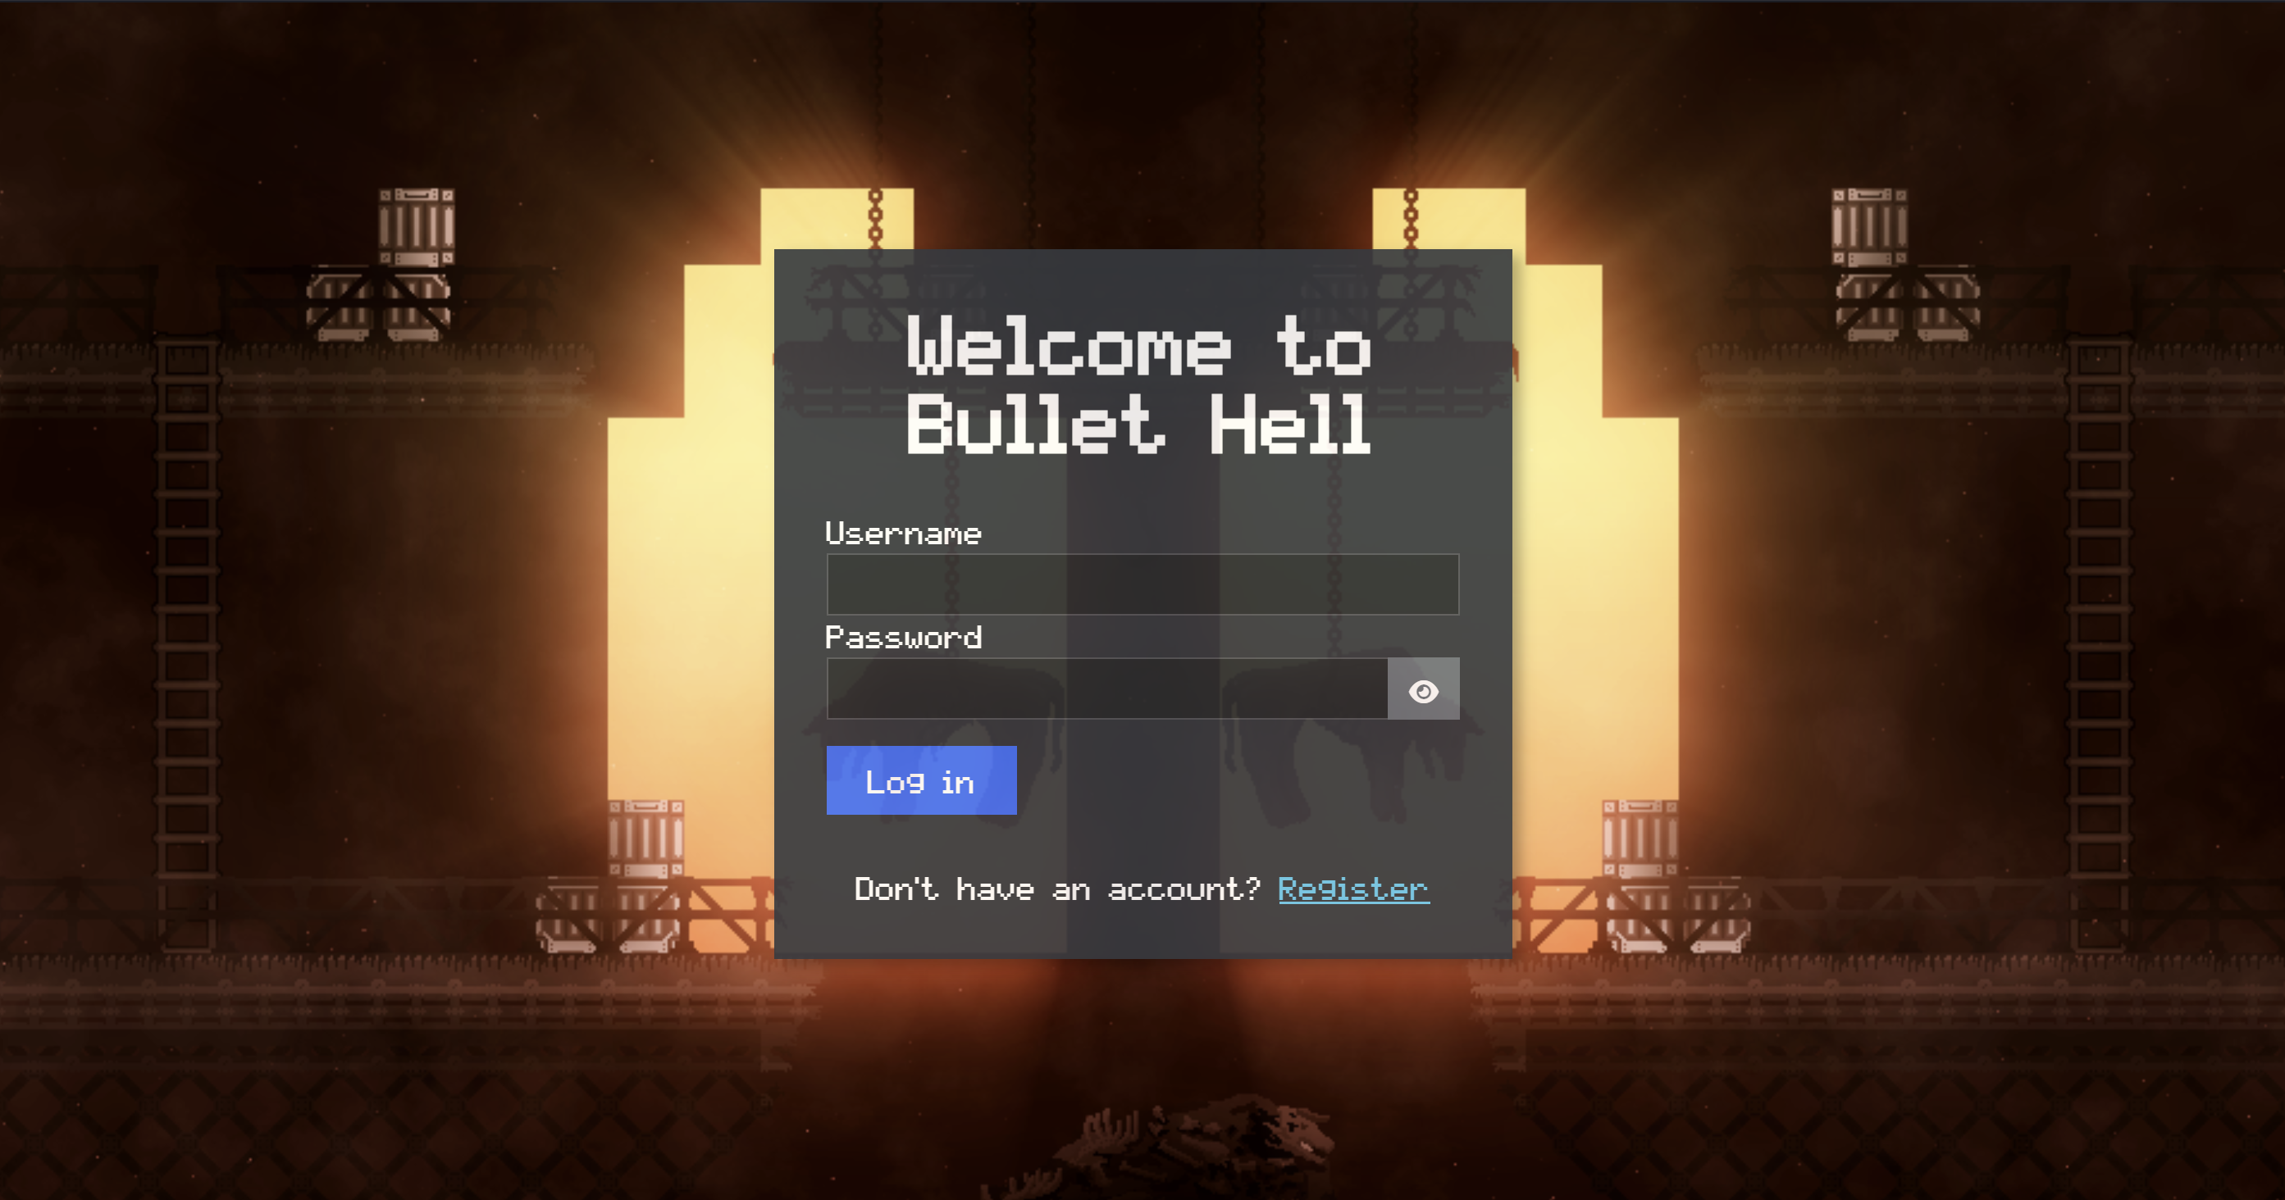
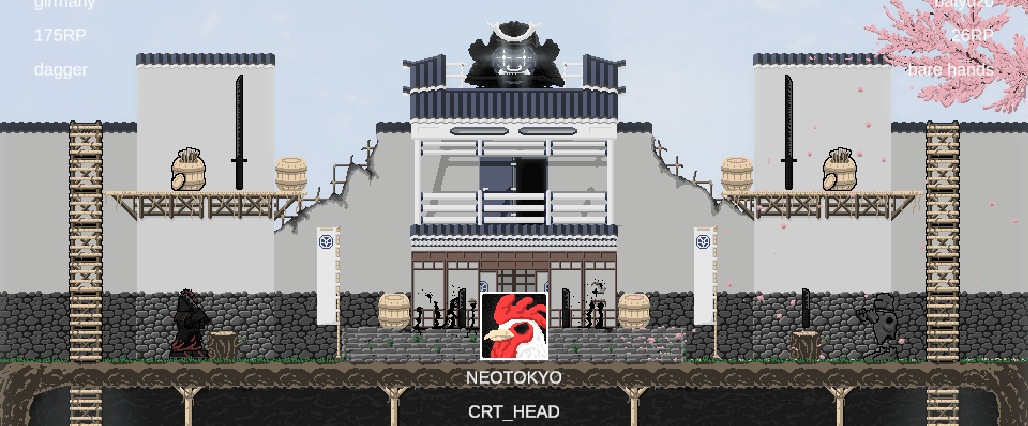
Overview

Slide 3
Areas of Responsibility
Nagy Dávid
Tokodi Mihály
Lehel Barnabás
- Game mechanics
- Weapon mechanics
- Character control
- Level design
- Graphic design
Database design
Security management
Admin functions
Frontend
Backend, API
Database design
Game API, Backend
Frontend
Codex functions

Slide 4
Project timeline
 | Sep | Oct | Nov | Dec | Jan | Feb | Mar | Apr
Game
Game API
Website
API
Assets
Dokumentáció
Lehel Barnabás
Nagy Dávid
Tokodi Mihály

Slide 5
Website

Slide 6



Goals and Technology
-Target audience:
Bullet Hell Players
-Goal:
- encyclopedia
- Player profile
- Leaderboard
- Admin responsibilities

Slide 7
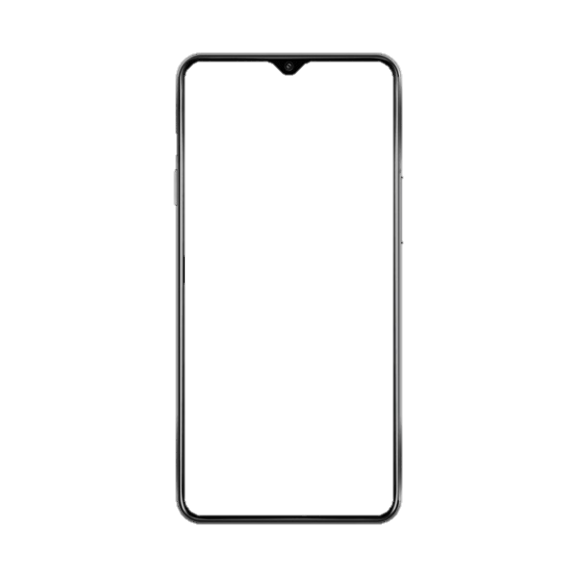
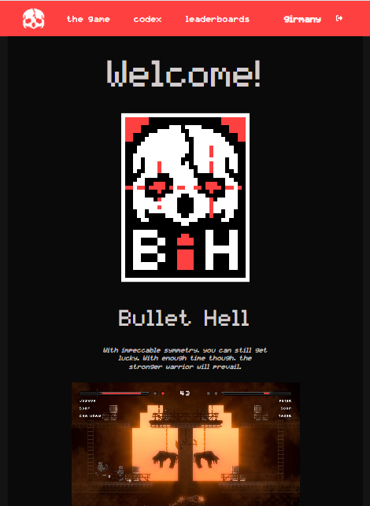

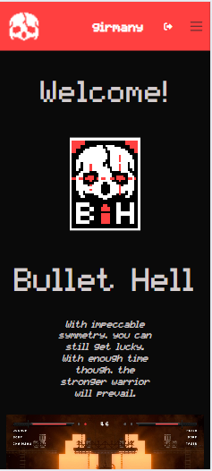
Responsiveness

Slide 8
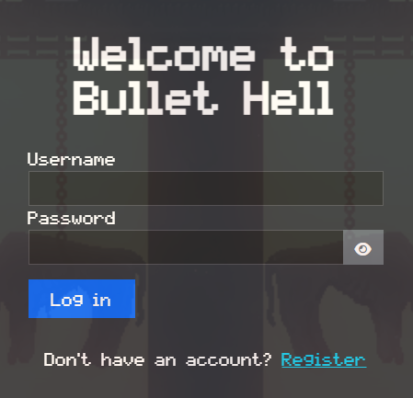
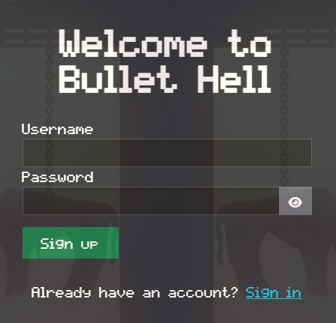
Login & Registration

Slide 9
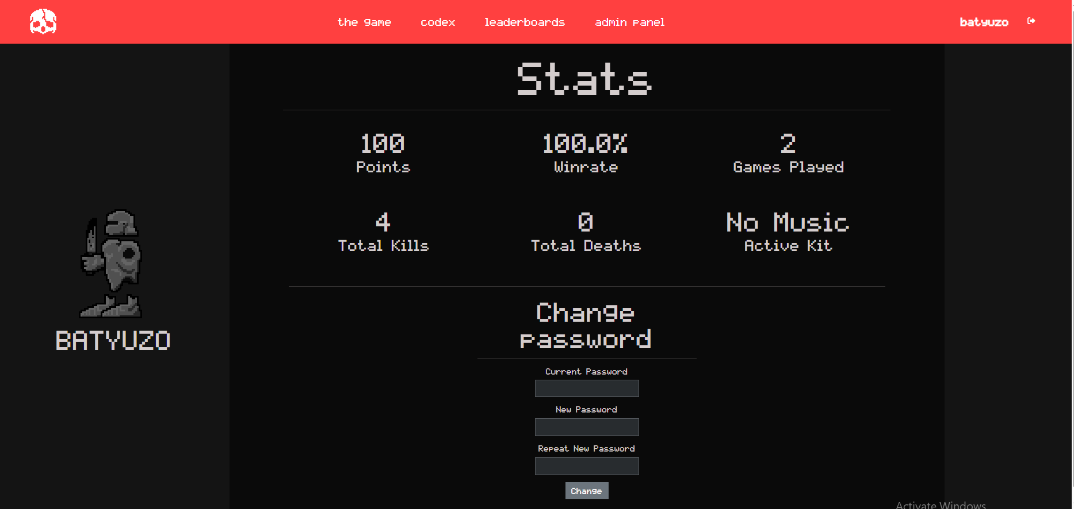
Navigation & Profile

Slide 10
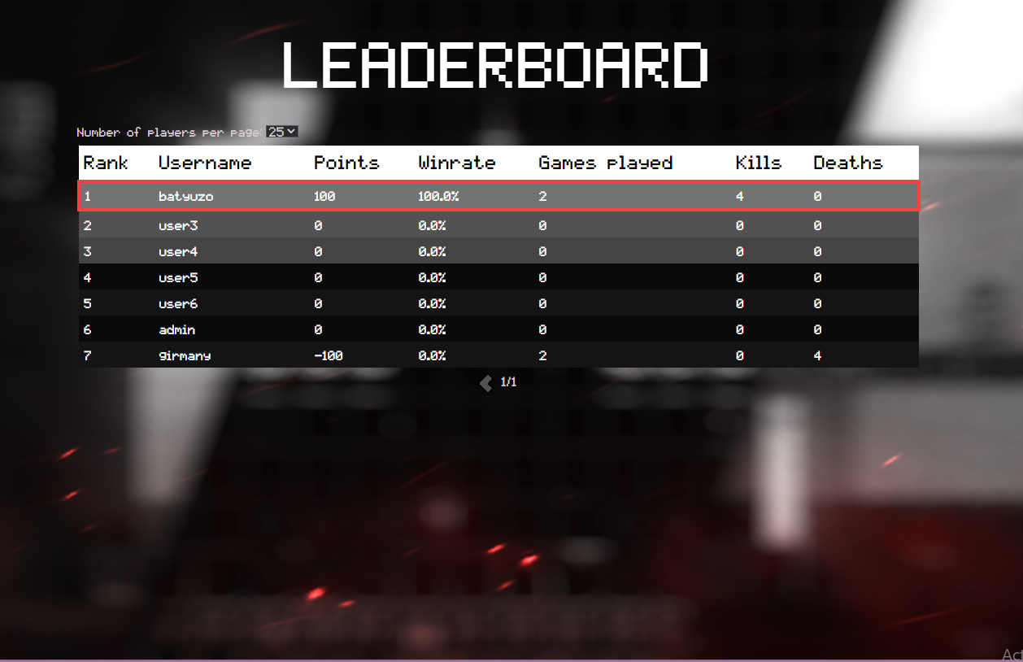
Leaderboard

Slide 11
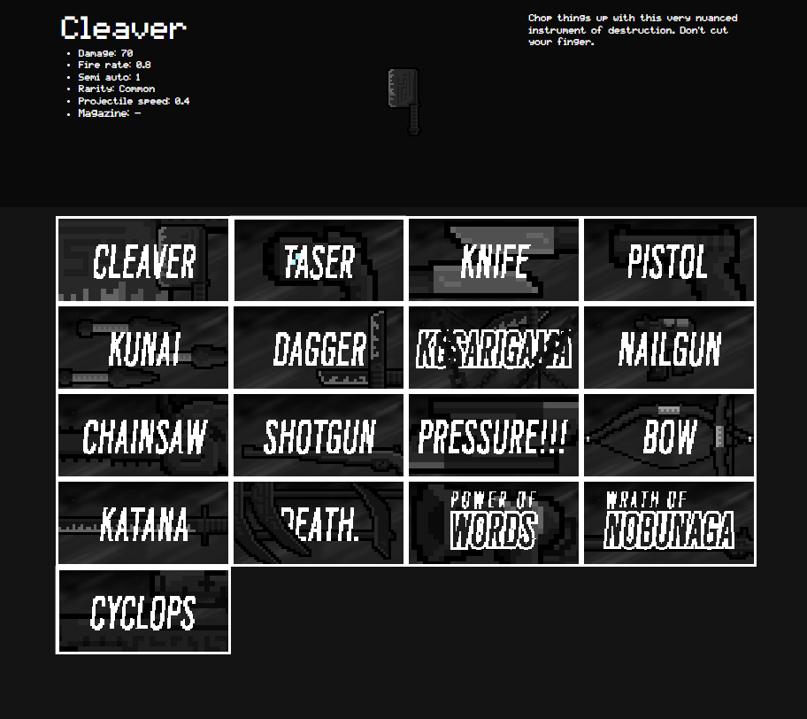
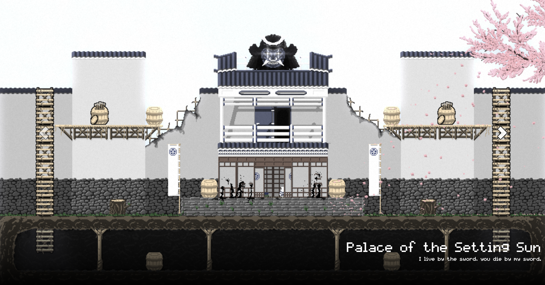
Codex - Maps, Weapons

Slide 12
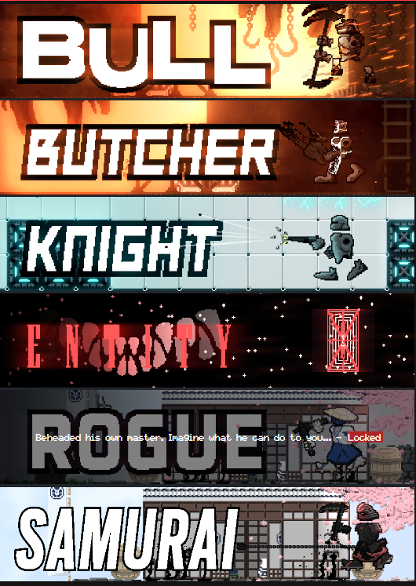
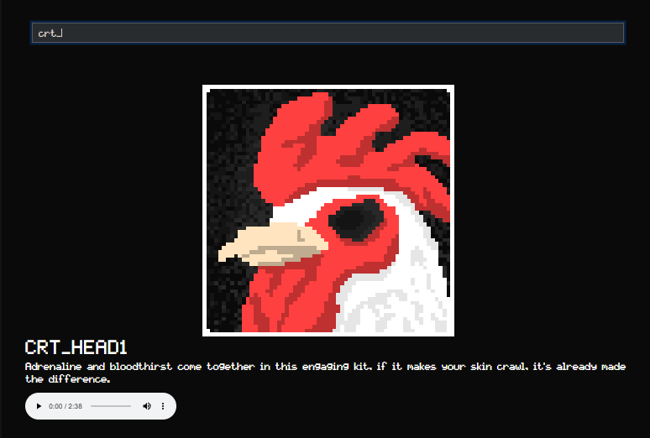
Codex - Characters, Music

Slide 13
User privileges
-Admin user
- View / Delete users
- View / Delete / Add Weapons
- View / Delete / Add Maps
- View / Delete / Add Music
-Player user
- View Codex
- View Leaderboard
- View own profile

Slide 14
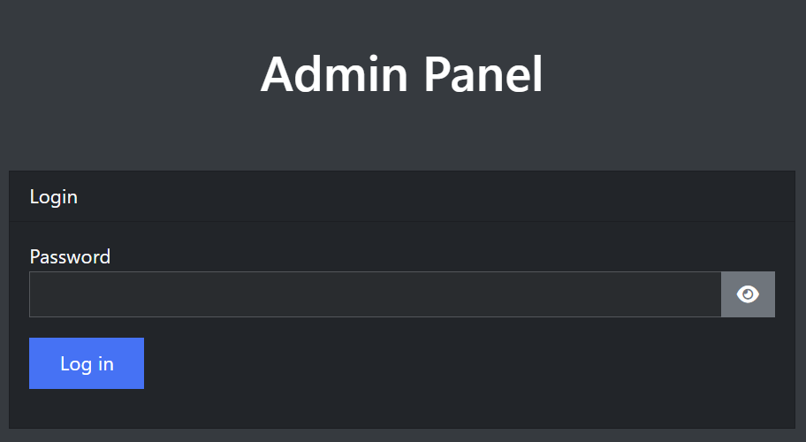
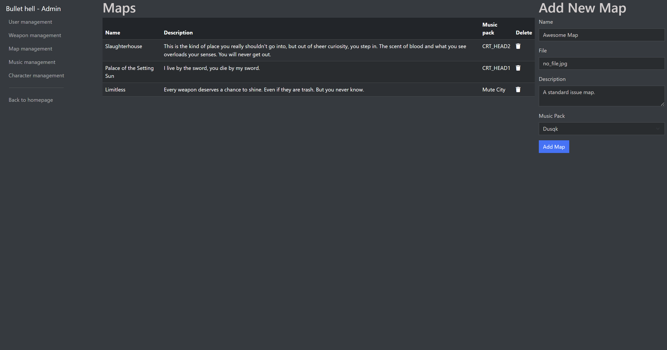
Admin panel

Slide 15
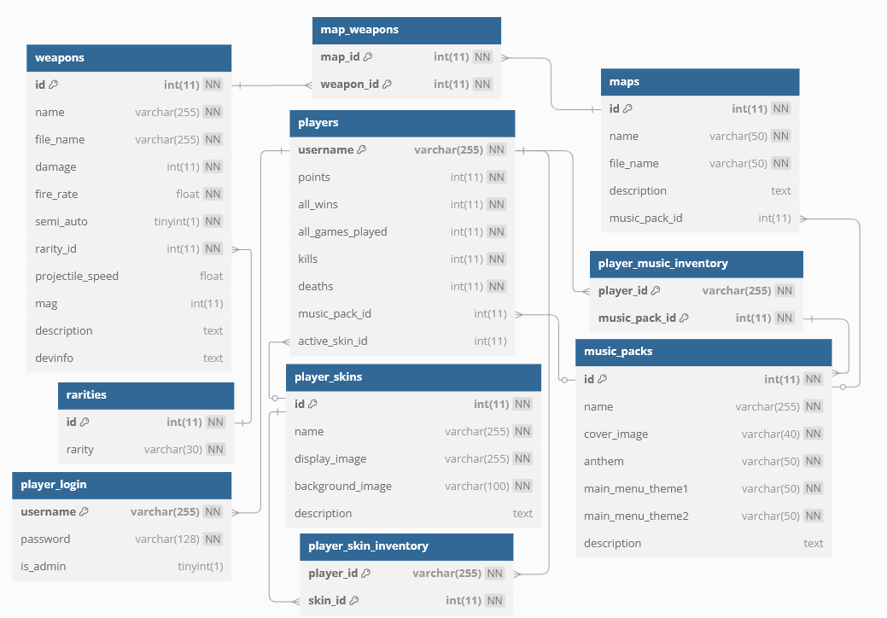
Database

Slide 16
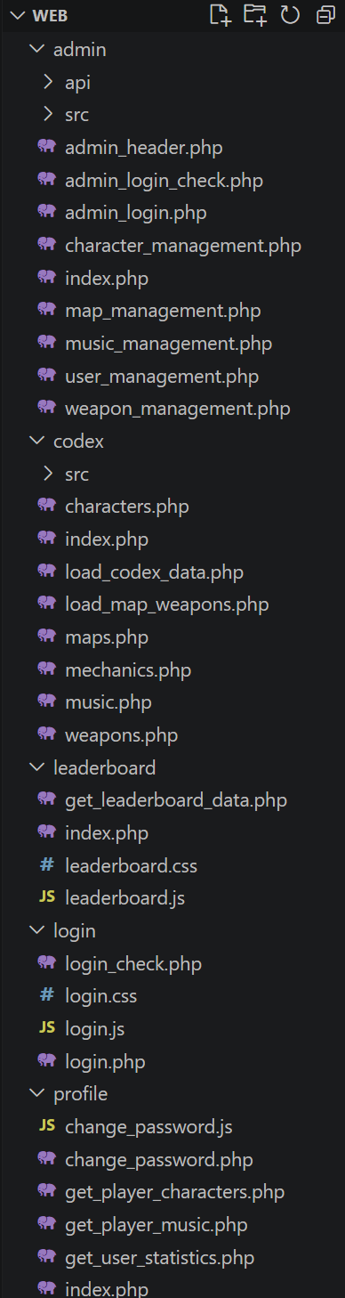
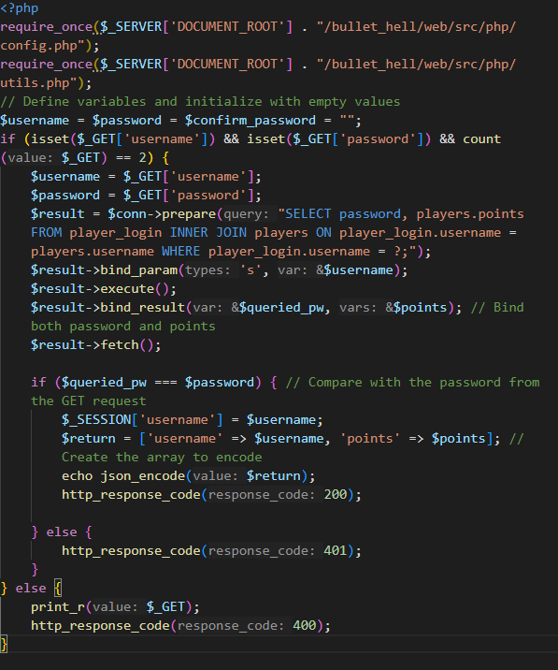
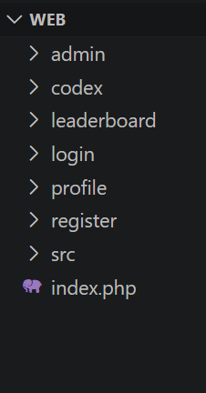
Structure - API

Slide 17
Challenges
- Writing our own API & jQuery, AJAX
- Login & Register system
Codex carousel, display
Table pagination
Safe database handling
Keeping the responsiveness

Slide 18
The game

Slide 19




Goals and Technology
- 1v1
- Skill based
- Local Multiplayer

Slide 20
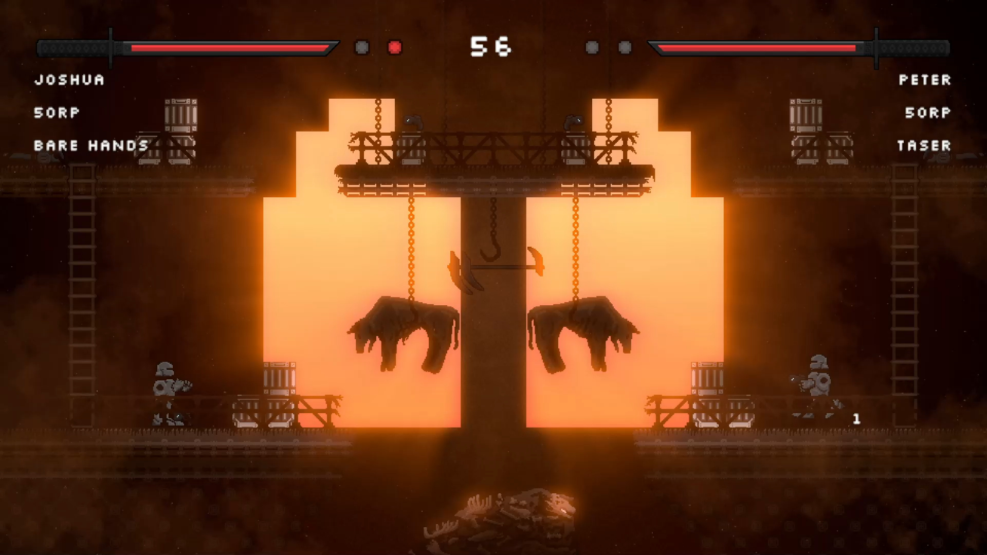
Gameplay

Slide 21
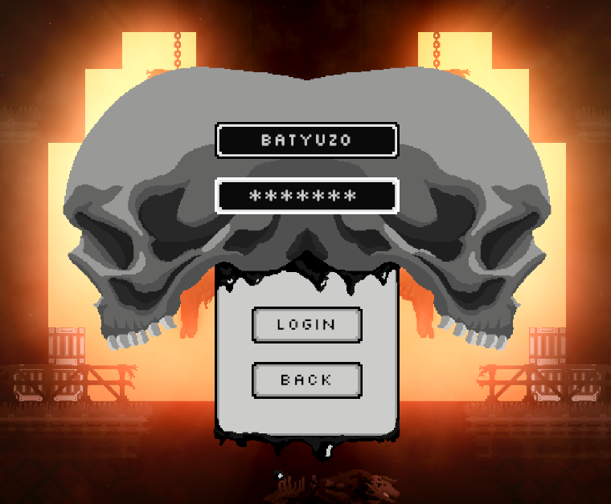
Login

Slide 22
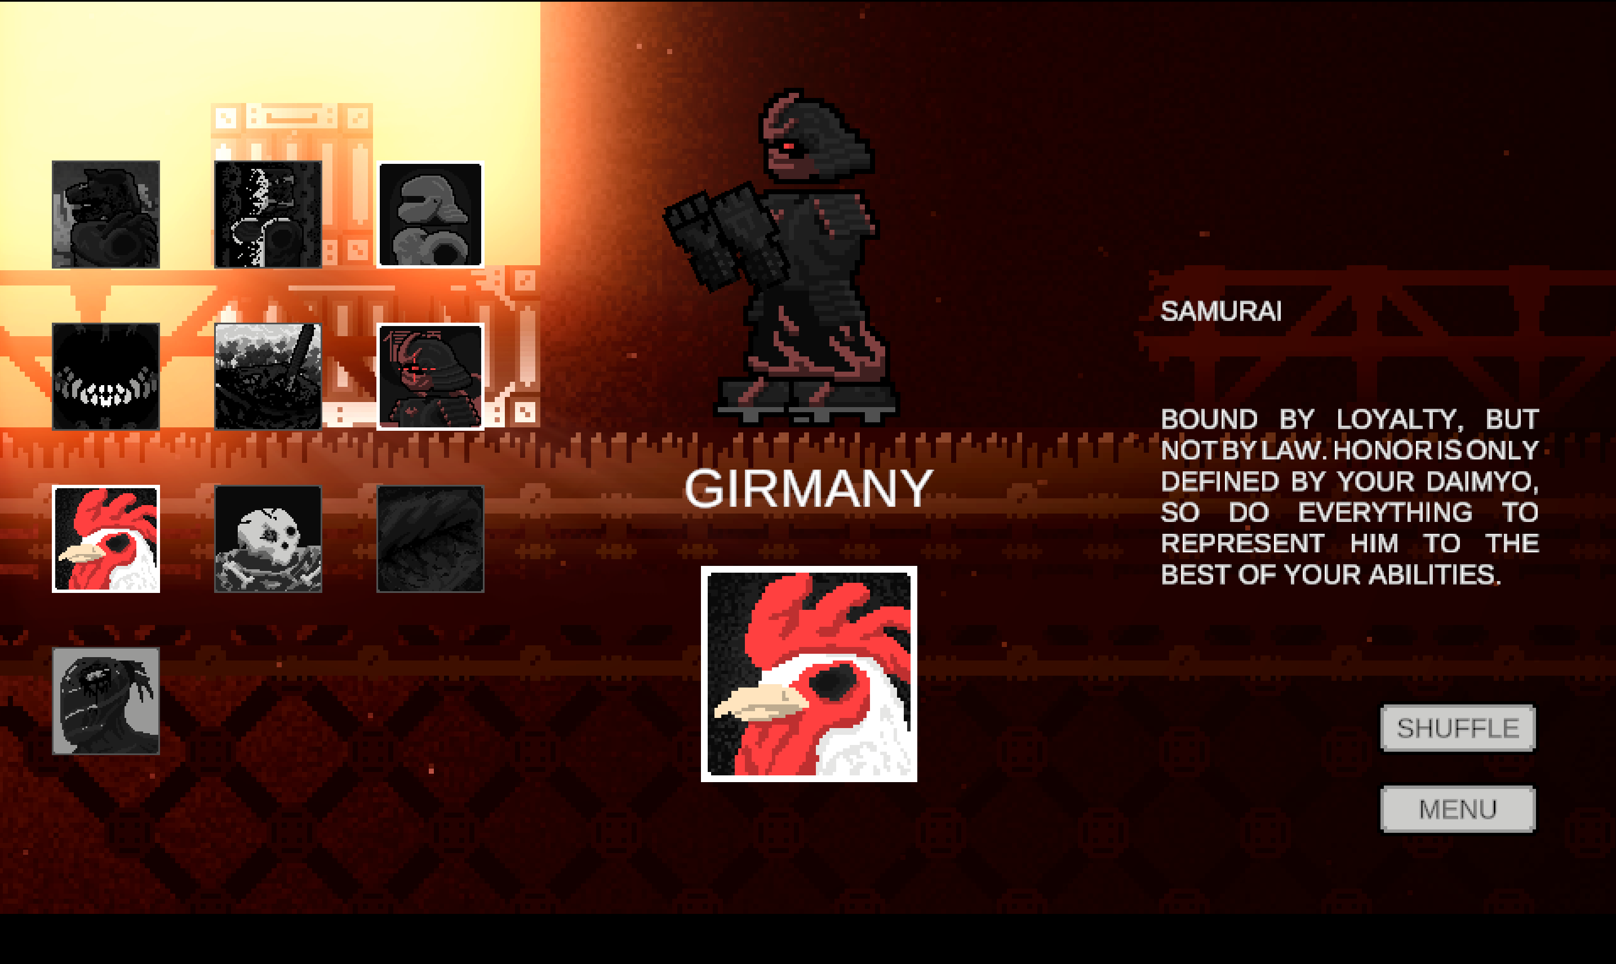
Characters, music

Slide 23


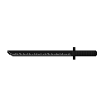

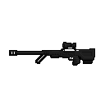
Weapons
Unique characteristics
Unique stats

Slide 24
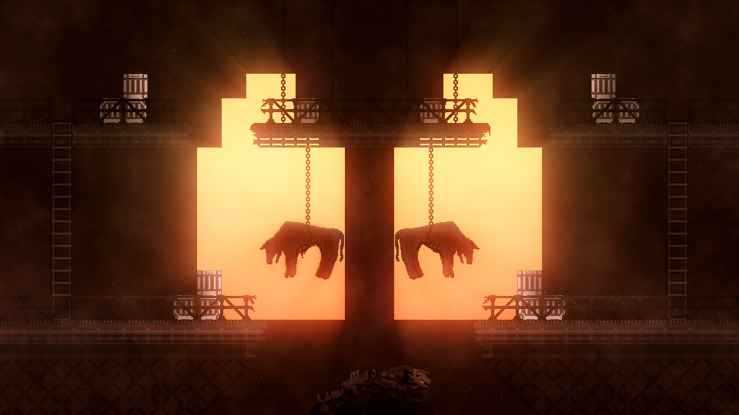
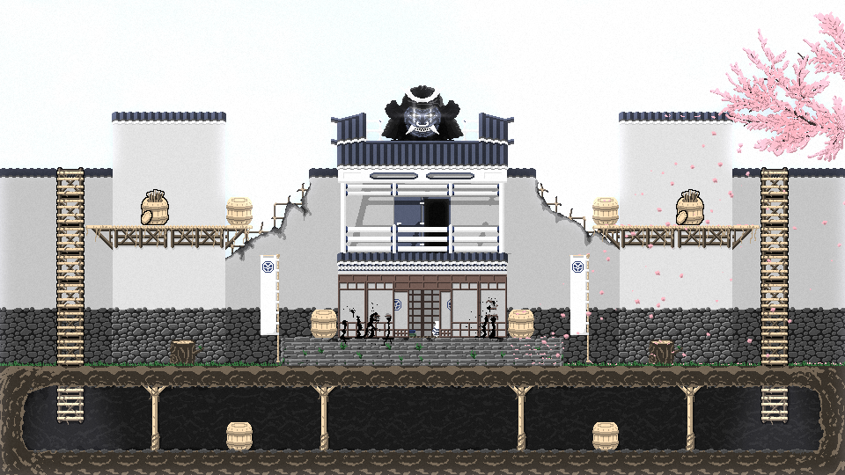
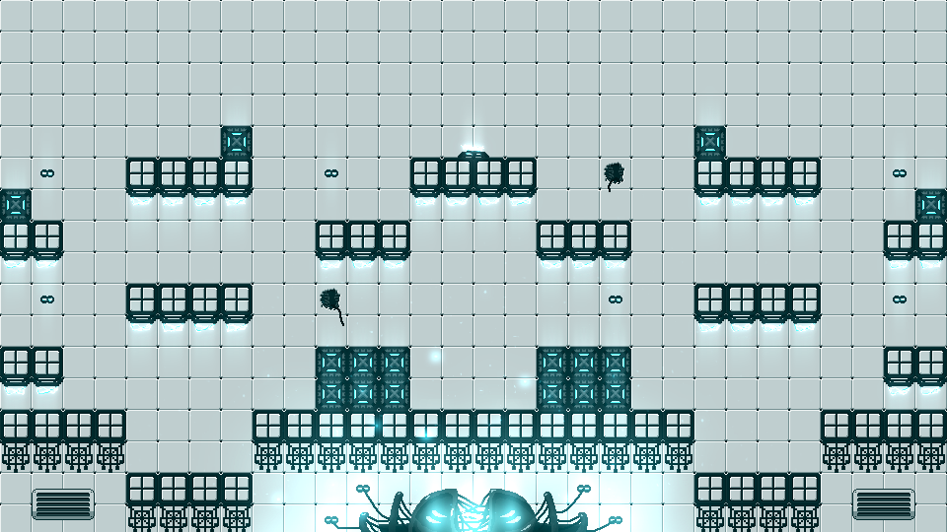
Maps

Slide 25
Challenges
- Writing our own API, UnityWebRequest
- Multiplayer controls
- Gameplay logics
- Combat system

Slide 26
Testing process
Functional testing
New Feature Validation
API Endpoint Checks
Playtesting
User Experience Feedback
Gameplay Balance Tuning
Bug Hunting

Slide 27
Opportunities for further development
- Online multiplayer
- Making password handling safer
Pixel perfect font
More balanced game
More content
- Admin panel search and edit

Slide 28
Summary
- Game ✅
- Responsive website ✅
- API ✅
-Takeaways
- Unity & C# experience
- Full-Stack development
- Version control
- Teamwork

Slide 29
Thank you!

